Slide 1

Big Bird: Transformers for Longer Sequences
Manzil Zaheer, Guru Guruganesh, Avinava Dubey, Joshua Ainslie, Chris Alberti, Santiago Ontanon, Philip Pham, Anirudh Ravula, Qifan Wang, Li Yang, Amr Ahmed

Slide 2
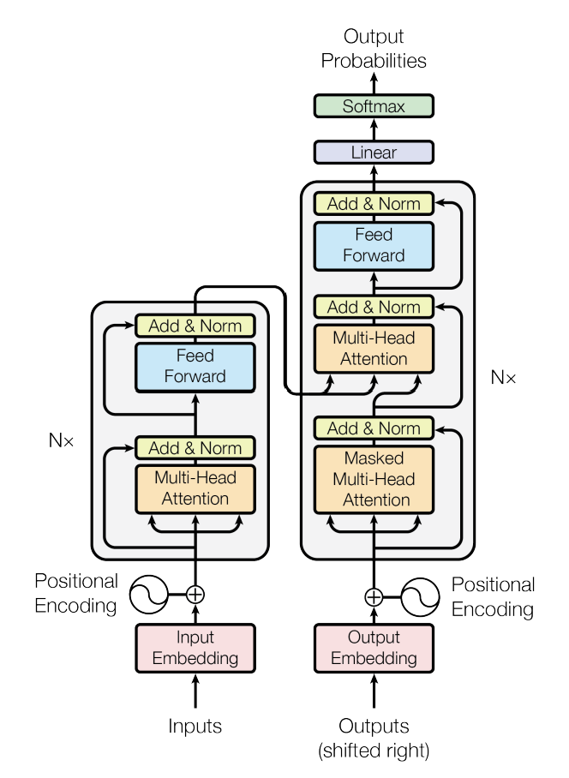
Transformer sequence to sequence model
The key innovation in Transformers is
the introduction of a self-attention mechanism

Slide 3
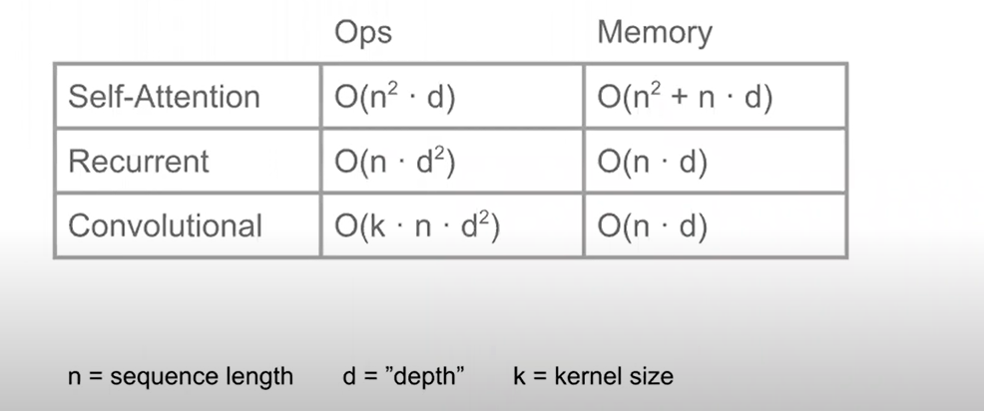
Transformers
ADVANTAGES
LIMITATIONS
Parallelization
Faster to run and train
Handling long-range dependencies
Scalability
…..
Expensive
Memory Intensive
Struggle with Handling Extremely Long Sequences
…..

Slide 4
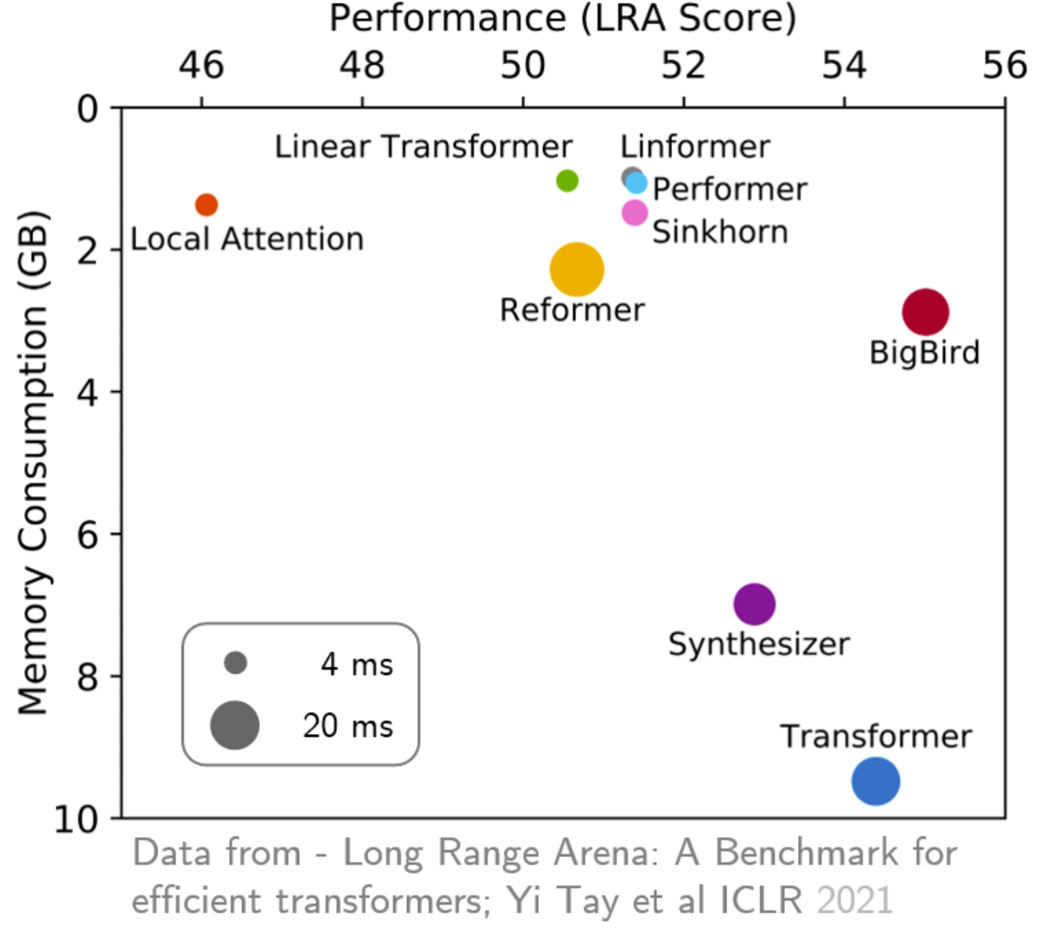
Performance

Slide 5
Background and motivation
Full attention mechanism is expensive and memory intensive
Proposed Method-Bigbird
Main Idea- Sparse attention

Slide 6
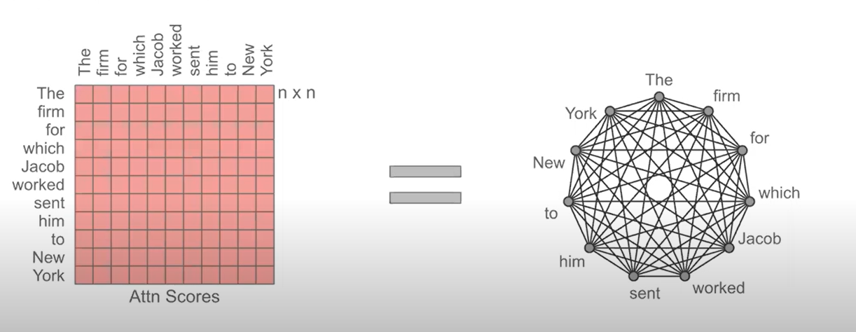
Full Attention Graph

Slide 7
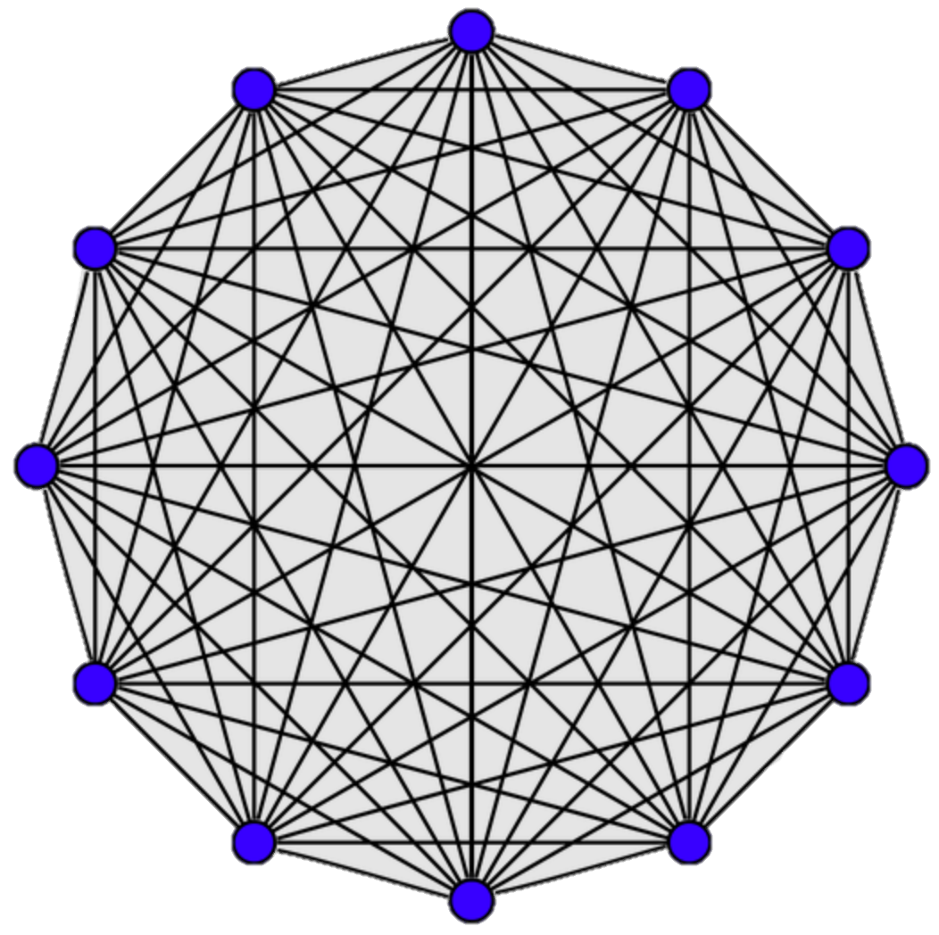
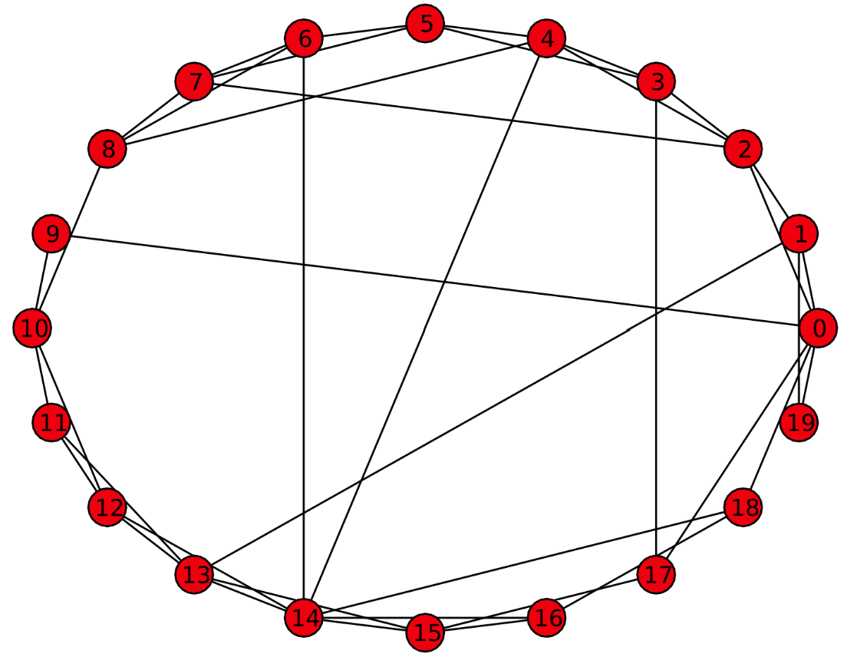
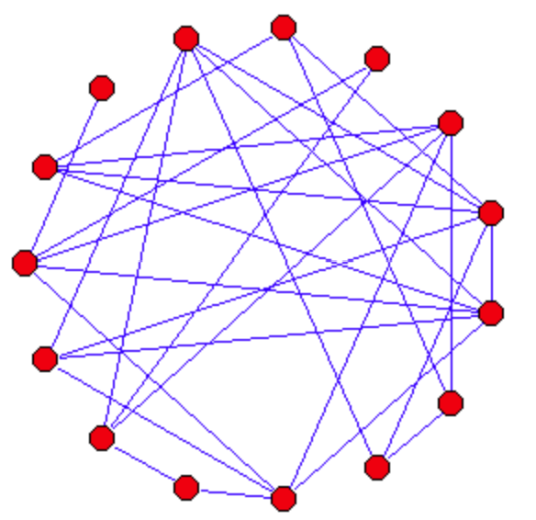
Questions
Do we need all the edges
What we need is ease of Information Flow
Measure:Mixing time
Many random Graph models e.g. Erdos Renyi, Watts-strogatz replicate it
Complete
Watts-strogatz
Erdos Renyi

Slide 8
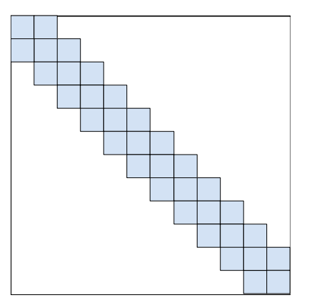
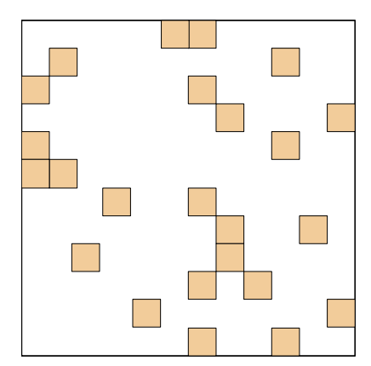
Locality+Random

Slide 9
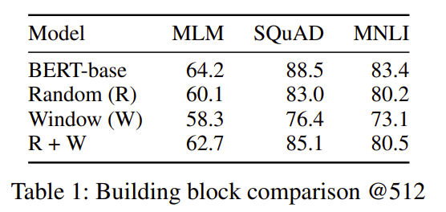
Applied the Mask to standard Models Good but not enough

Slide 10
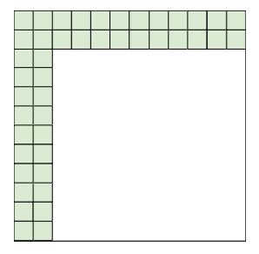
Something Missing!
Need Global connections
Look at proof of universal approximation
It needs some nodes connected to everyone

Slide 11
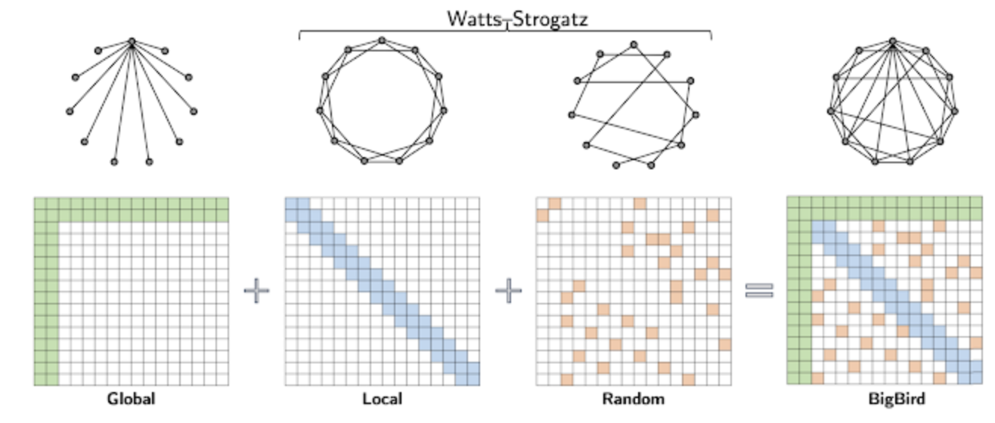
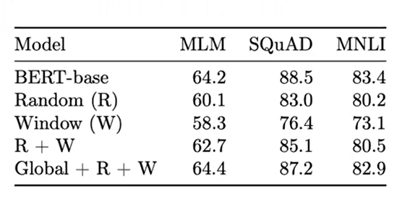
Final Attention Pattern

Slide 12
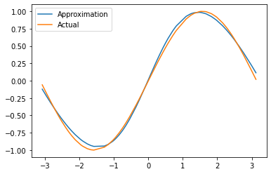
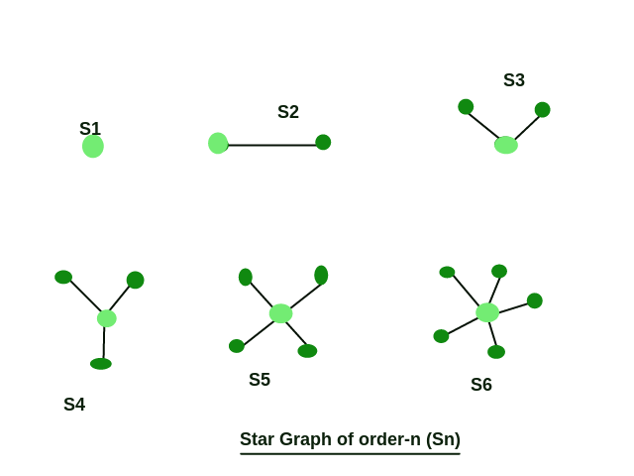
Universal Approximators
It must be able to learn any continuous function approximately
Shows how a mechanism can approximate the relationships
Combines smaller pieces

Slide 13
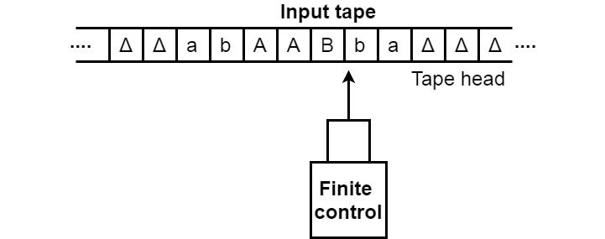
Turing Completeness
System is capable of solving any kind of problem as long as it has enough resources

Slide 14
Limitation
Original Full Attention Transformer can perform a task in O(1) layers
All Sparse Attention Transformers including Bigbird need Ω(n) layers

Slide 15
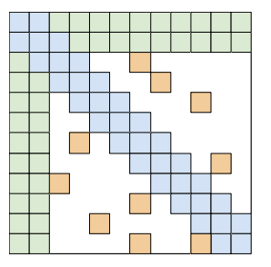
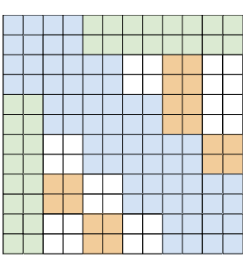
Implementation
Arbitrary Graph not Good on SIMD devices like GPU/TPU
Using gathers can be slow and expensive
Blockify
Reduce gathers
Enables Rolling

Slide 16
Experiments
Pretraining and MLM
Encoder only Task
QA
Classificatio
Encoder-Decoder Task
Summarization
Genomics

Slide 17
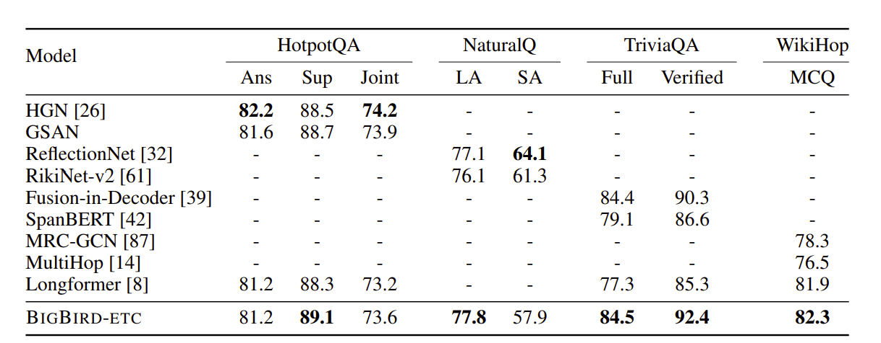
Question Answering (QA)
Transformer due to memory restriction can only take in fewer context (less documents)
Bigbird can take in more context therefore generate more accurate answers

Slide 18
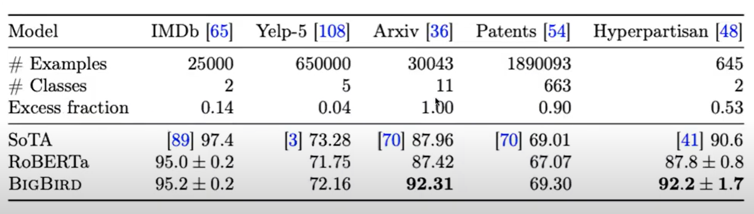
Document Classification

Slide 19
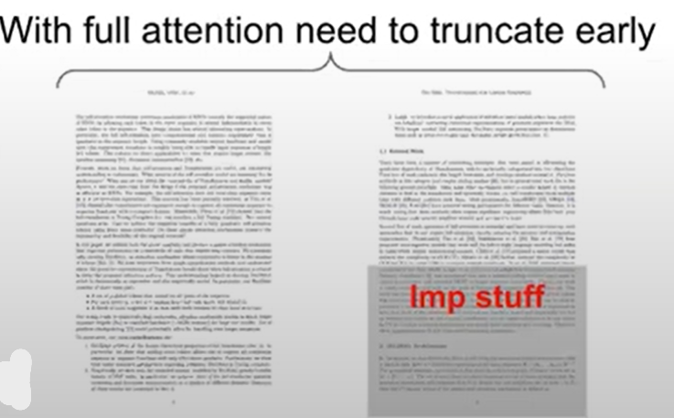
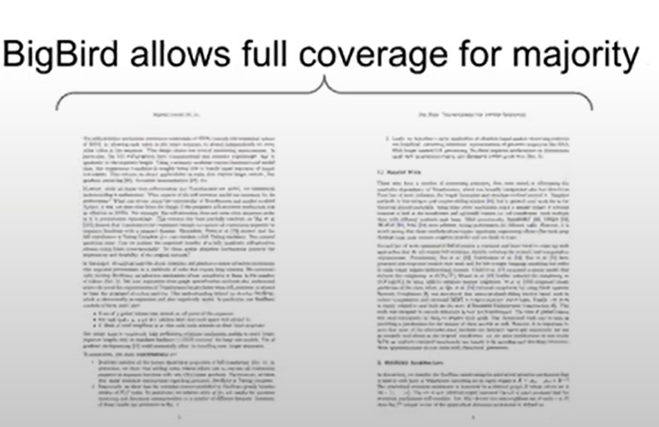
Summarization
Generative Task : Encoder-Decoder
the salient content can be evenly distributed in the long document, not just in first 512 tokens
longer documents exhibit a richer discourse structure and summaries are considerably more abstractive, thereby observing more context helps
Only Encoder need long sequence

Slide 20
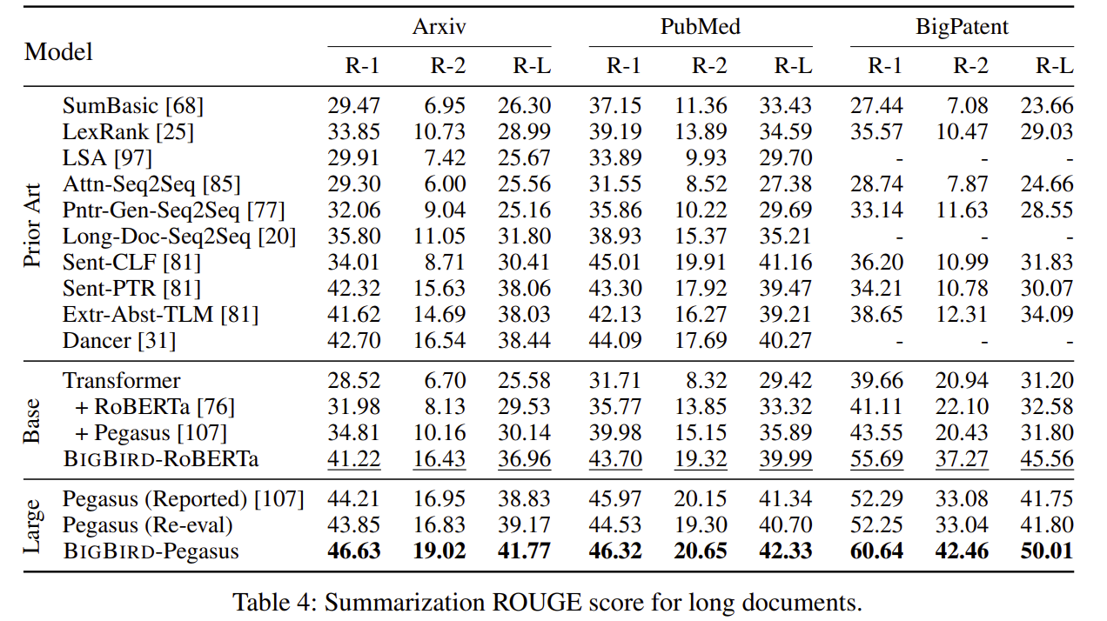
Summarization ROUGE score for long documents

Slide 21
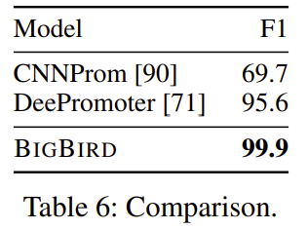
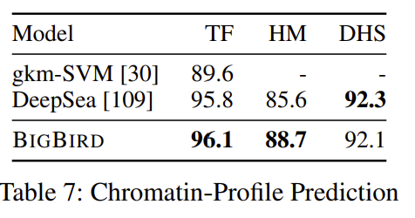
Genomic Sequences
Promoter Region Prediction
Identify transcription initiation site in DNA
Bigbird achieves SoTA on classifying DNA as promoter regions
Chromatin-Profile Prediction
Jointly predict 919 functional effects on DNA fragments
AUC on held-out DNA fragment
SoTA for HM, known to have long-range correlation

Slide 22

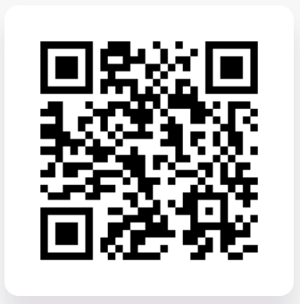
Thank You!

